Slide 1
Lab 01
Breadboard Techniques and Logic Function Demonstration
Source: Purdue ECE270

Slide 2
Instructional Objectives:
To become familiar with the Digital Tool Kit
To learn how to build and test digital circuits using the Breadboard
To learn about basic logic functions such as AND, OR, NOT, NAND, NOR, and XOR

Slide 3
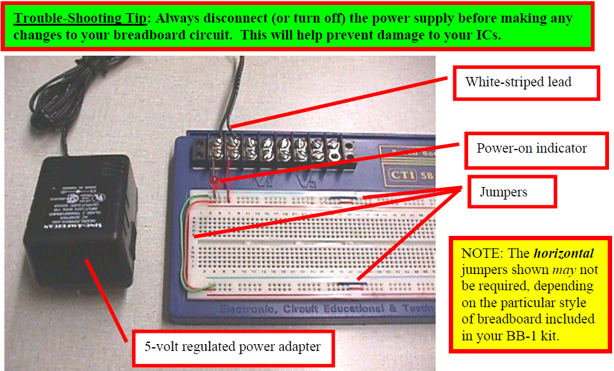
Step (1): Power and Ground Jumper Installation:

Slide 4
Step (1): Power and Ground Jumper Installation:
Connect the power supply (+5V) and ground to your breadboard.
(Make sure the “red rail” is +5 VDC and the “blue rail” is ground.)
Connect a red (resistor) LED between the power and ground rails in the
“upper left hand corner” of your board to serve as a “power on” indicator.
(NOTE: The “long” lead of the LED is the anode, which should be connected
to “red rail”.)
This will hopefully serve as a reminder to ALWAYS turn OFF power to your
board BEFORE inserting or removing ANY parts or wires.

Slide 5
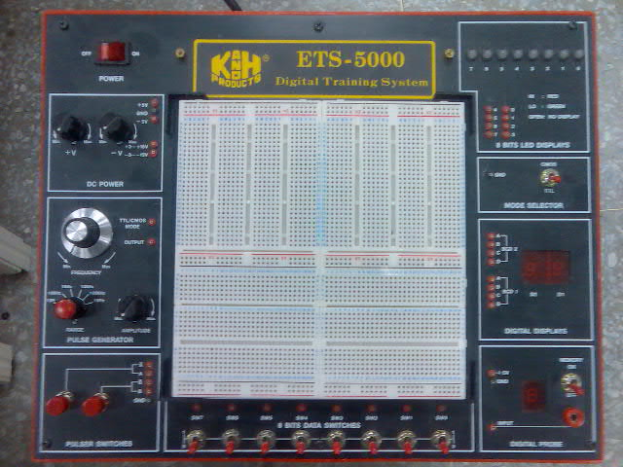
DC Power
LED
7-segment
Switches

Slide 6
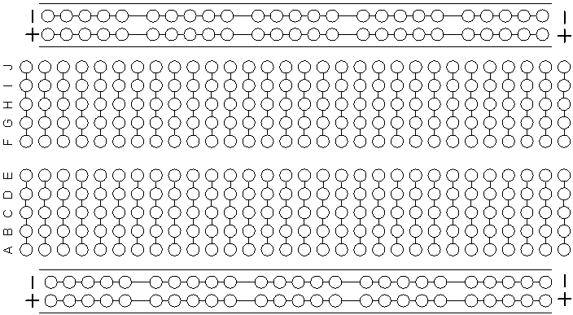
麵包板 (Breadboard)

Slide 7
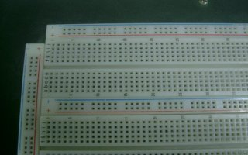
Breadboard
These five points are electrical equivalent.
Ground
Vcc

Slide 8
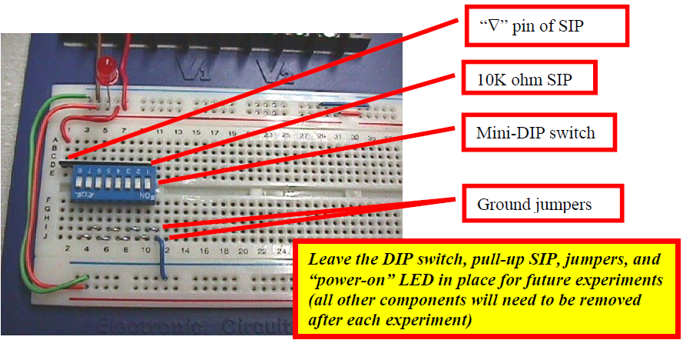
Step (2): DIP Switch and Pull-up SIP Wiring
Insert the mini-DIP switch into your board, along with the 10K ohm resistors
Connect all the “ON” side pins of the mini-DIP switch to the ground rail.
Test each switch with the digital multi-meter (DMM) to make sure that the switch
outputs “0.0 volts” when the switch is in the “DOWN” (or “ON”) position, and
outputs (approximately) “5.0 volts” when the switch is the “UP” (or “OFF”) position.

Slide 9
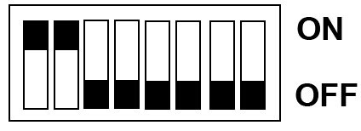
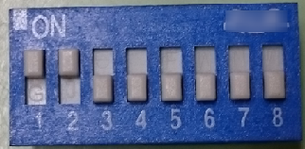
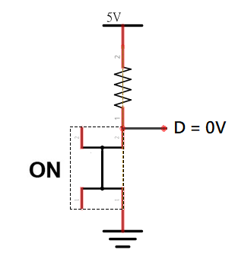
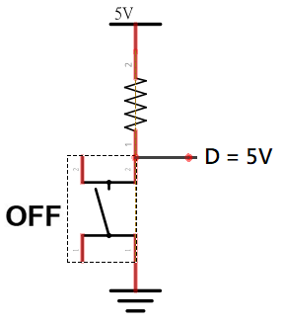
DIP Switch
A dip switch is a set of small switches in a dual in-line package (DIP) that is used
to change the operating mode of a device.
In our experimental setup, the operation of the circuit is as follows,
When “ON”, the voltage measured at D is 0V.
When “OFF”, the voltage measured at D is 5V

Slide 10
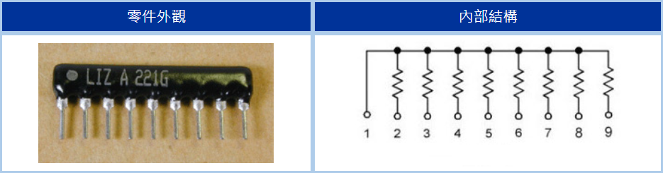
排阻

Slide 11
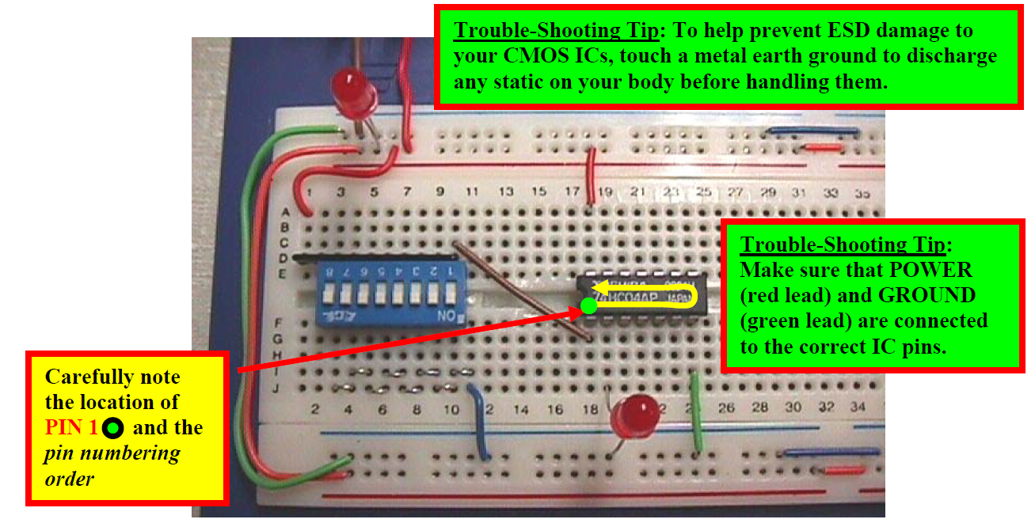
Step (3): Inverter and LED Test:
Locate a 7404 (hex inverter) IC and insert it into your breadboard.
Connect the 7404 to power (pin 14) and ground (pin 7).
Connect one of the inputs (pin 1) to one of the DIP switches, and connect
the corresponding output (pin 2) to the anode of a RED LED
(connect the cathode of the LED to ground).

Slide 12
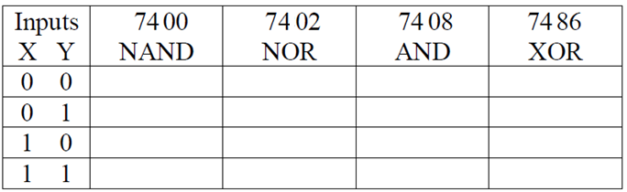
Step (4): NAND, NOR, AND, and XOR Truth Tables
Repeat Step (3), using a 7400 (quad 2-input NAND),
7402 (quad 2-input NOR), 7408 (quad 2-input AND), and
7486 (quad 2-input XOR).
To demonstrate each of these functions, you will need to test
all four input combinations.
Complete the TRUTH TABLE, below, for each of the four functions

Slide 13
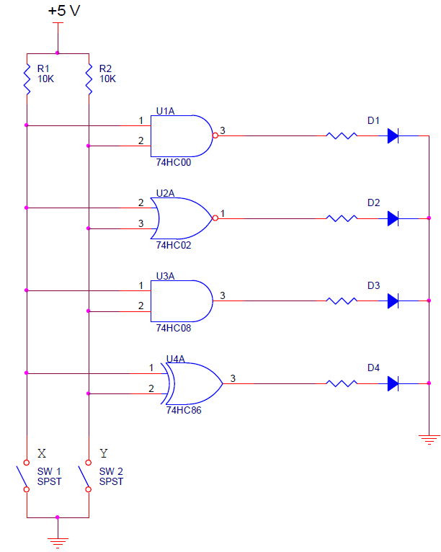
Step (5): Schematic Capture
Draw a complete schematic of the circuit you implemented for Step (4),
using paper and pen.
Your completed schematic should look similar to the one below, but not the same.
Attach a write-up of your schematic to your lab report.

Slide 14
Step (6): What-If Test
Determine what happens if you try to connect an LED directly to
the DIP switch/pull-up resistor circuit.
First, try connecting the anode of an LED to the switch and
the cathode to ground.
Next, try connecting the LED’s anode to +5 V and its cathode to the switch.
Describe the results obtained and explain what is happening in each case.

Slide 15
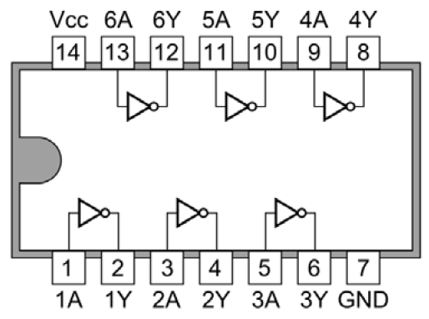
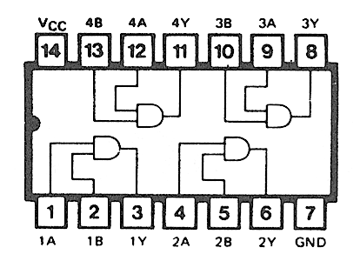
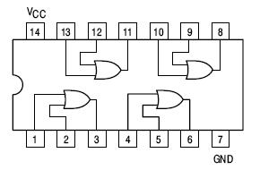
Logic Gates
NOT gate
IC : 7404
AND gate
IC : 7408
OR gate
IC : 7432

Slide 16
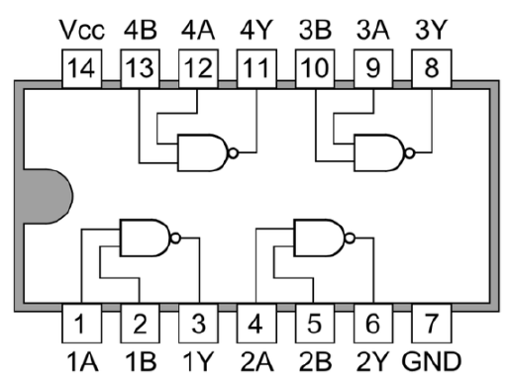
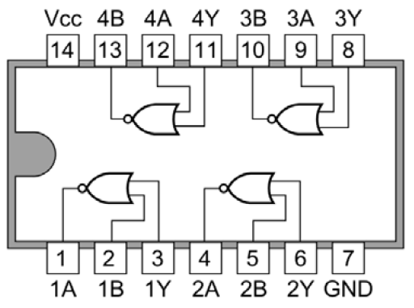
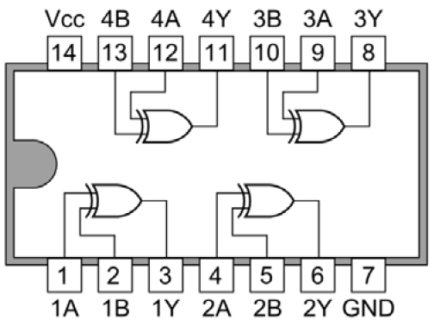
Logic Gates
NAND gate
IC : 7400
NOR gate
IC : 7402
XOR gate
IC : 7486

